Slide 1
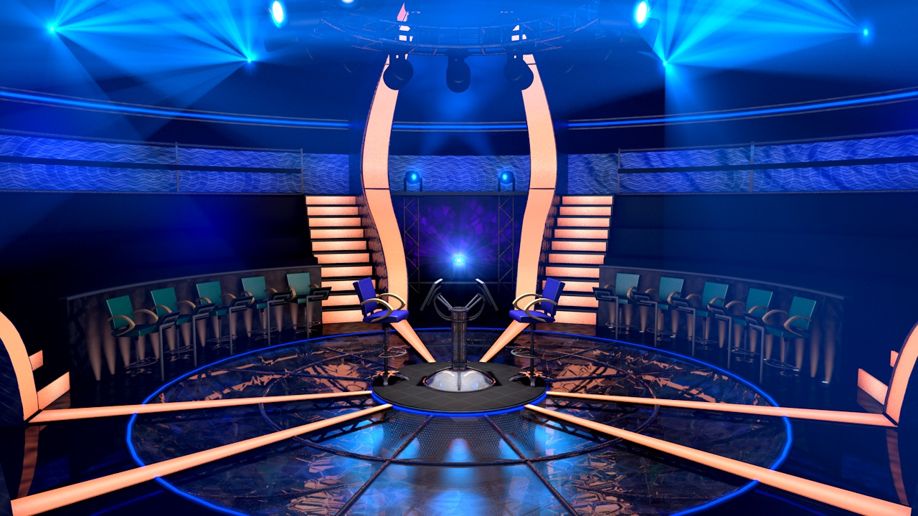


Slide 2
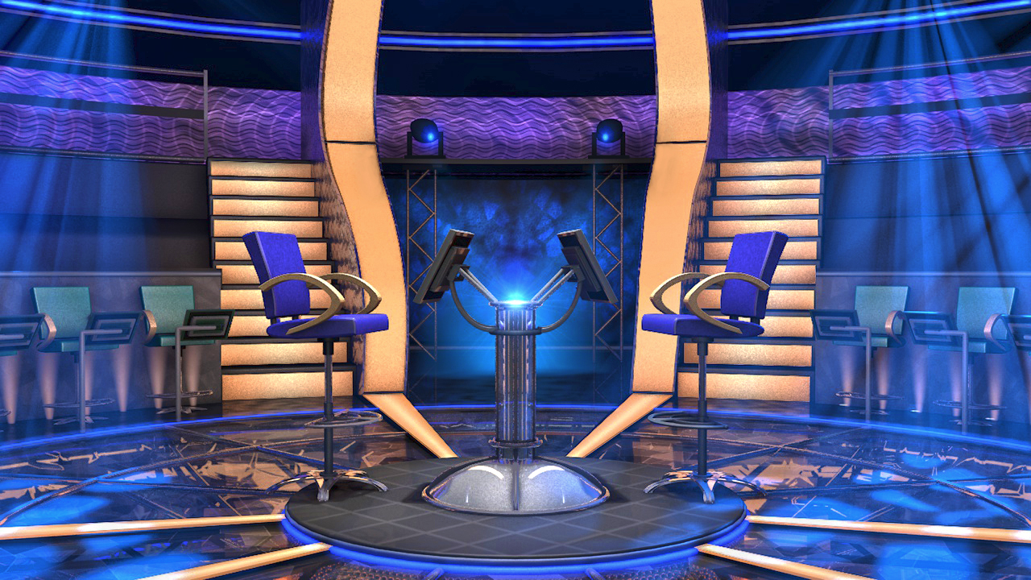




Question BGM
Câu hỏi 1…………………………………………………..
Q Select
$1,000,000
Q Right
$500,000
$250,000
CLOSE
Q Wrong
$100,000
$50,000
00
$25,000
START
TIMER
$16,000
$8,000
IS THAT YOUR FINAL ANSWER?
END
$4,000
$200
$2,000
YES
NO
$1,000
sai
đúng
$500
A
B
$300
1
2
$200
sai
sai
$100
C
D
CORRECT ANSWER
END
CONTINUE
Bắt đầu

Slide 3
Question BGM
Câu hỏi 2 …………………………………………………..
Q Select
$1,000,000
Q Right
$500,000
$250,000
CLOSE
Q Wrong
$100,000
$50,000
00
$25,000
START
TIMER
$16,000
$8,000
IS THAT YOUR FINAL ANSWER?
END
$4,000
$200
$2,000
YES
NO
$1,000
đúng
sai
$500
A
B
$300
1
2
$200
sai
sai
$100
C
D
CORRECT ANSWER
END
CONTINUE
Bắt đầu

Slide 4
Question BGM
Câu hỏi 3…………………………………………………..
Q Select
$1,000,000
Q Right
$500,000
$250,000
CLOSE
Q Wrong
$100,000
$50,000
00
$25,000
START
TIMER
$16,000
$8,000
IS THAT YOUR FINAL ANSWER?
END
$4,000
$200
$2,000
YES
NO
$1,000
sai
đúng
$500
A
B
$300
1
2
$200
sai
sai
$100
C
D
CORRECT ANSWER
END
CONTINUE
Bắt đầu

Slide 5
Question BGM
Câu hỏi 4…………………………………………………..
Q Select
$1,000,000
Q Right
$500,000
$250,000
CLOSE
Q Wrong
$100,000
$50,000
00
$25,000
START
TIMER
$16,000
$8,000
IS THAT YOUR FINAL ANSWER?
END
$4,000
$200
$2,000
YES
NO
$1,000
sai
sai
$500
A
B
$300
1
2
$200
đúng
sai
$100
C
D
CORRECT ANSWER
END
CONTINUE
Bắt đầu

Slide 6
Question BGM
Câu hỏi 5…………………………………………………..
Q Select
$1,000,000
Q Right
$500,000
$250,000
CLOSE
Q Wrong
$100,000
$50,000
00
$25,000
START
TIMER
$16,000
$8,000
IS THAT YOUR FINAL ANSWER?
END
$4,000
$200
$2,000
YES
NO
$1,000
sai
sai
$500
A
B
$300
1
2
$200
đúng
sai
$100
C
D
CORRECT ANSWER
END
CONTINUE
Bắt đầu

Slide 7

KỂ TỪ CÂU HỎI SỐ 5 TRỞ ĐI BẠN CÓ THÊM 2 SỰ TRỢ GIÚP
50/50 VÀ HỎI Ý KIẾN THẦY CÔ DỰ GIỜ
50/50
Fifty Fifty
Ask the Audience
Plus One
TIẾP TỤC
Notes:
Đừng ấn chữ tiếp tục ấn ra ngoài sẽ sang slide tiếp

Slide 8

Question BGM
Câu hỏi 6…………………………………………………..
Q Select
$1,000,000
Q Right
$500,000
$250,000
CLOSE
Q Wrong
$100,000
$50,000
00
$25,000
START
TIMER
$16,000
$8,000
IS THAT YOUR FINAL ANSWER?
END
$4,000
$200
$2,000
YES
NO
$1,000
sai
sai
$500
A
B
$300
1
2
$200
đúng
sai
$100
C
D
50/50
CORRECT ANSWER
END
CONTINUE
Bắt đầu

Slide 9
Question BGM
Câu hỏi 7…………………………………………………..
Q Select
$1,000,000
Q Right
$500,000
$250,000
CLOSE
Q Wrong
$100,000
$50,000
00
$25,000
START
TIMER
$16,000
$8,000
IS THAT YOUR FINAL ANSWER?
END
$4,000
$200
$2,000
YES
NO
$1,000
sai
sai
$500
A
B
$300
1
2
$200
đúng
sai
$100
C
D
50/50
CORRECT ANSWER
END
CONTINUE
Bắt đầu

